Slide 1
Welcome to Year 1

Slide 2
School Mission Statement
Growing in knowledge and in the love of Jesus.
This underpins all that we do at St. Martin of Porres Catholic Primary School.

Slide 3
Class Prayer
Dear God,
Thank you for our homes, school and friendship.
Thank you for everything.
Amen

Slide 4
Class teacher - Miss Peters Support staff – Ms Keeley, Mrs Moloney
Staff working with your children

Slide 5
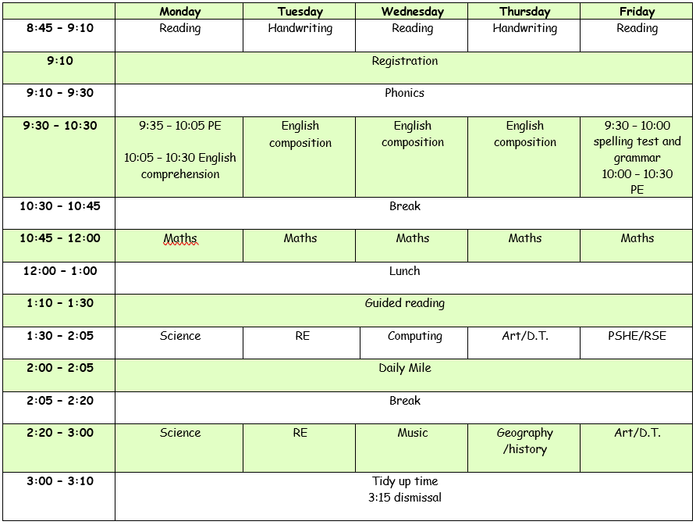
Class Timetable

Slide 6
What we are doing in Class 1
We will be focusing on transitioning the children from a play based curriculum to the National Curriculum. The focus will be on their:
Reading
Writing
Maths
Phonics

Slide 7
Religious Education in Year 1
In RE we will be following a curriculum called ‘Come and See’. We will be focusing on:
Family
Belonging
Loving – Waiting
Community – Special people
Relating - Meals
Giving - Change
Serving – Holidays
Inter-rating - Rules
World - Neighbours
We will be using and referring to biblical passages, analysing the
preachings and learning how we should follow in Jesus’ footsteps as Catholics.

Slide 8
Literacy Year 1
Non-fiction
Recount – personal experience
Non-chronological report
Instructions
Poetry
Rhyming couplets
Acrostic
Fiction
Fantasy: dragons, dinosaurs
Realistic
English will be focused on a different topic book each week. This books will help the children to discuss:
Characters
Settings
Fiction/non-fiction
Narrative
Difference and similarities (historical and geographical)

Slide 9
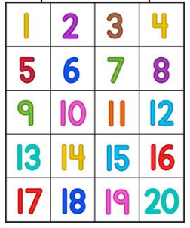
Maths in Year 1
In maths we will be focusing on using concrete, pictorial and abstract resources to promote a deep understanding of different mathematic concepts.
The focus will be on:
Place value
Addition and subtraction
Multiplication and division
Geometry: shapes, position, direction
Measurement: length, height, weight, volume, money, time
Fractions

Slide 10
Phonics in Year 1
In phonics we will be focusing on developing the children’s fluidity in their sounds ready for the phonics screening test in the summer term.
We will be developing on:
Single phonemes
Digraphs – th, sh, ch
Trigraphs – tch, igh,
Blending – s-l-igh-t = slight – writing
Segmenting – slight = s-l-igh-t - reading

Slide 11
End of Year 1 Expectations

Slide 12
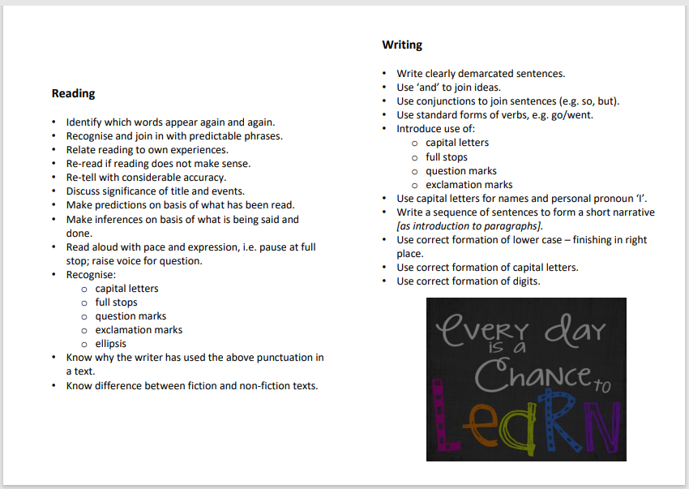
End of Year 1 Expectations

Slide 13
PE in Reception Class
PE will take place on a Monday and Friday. Monday’s PE lesson will be taken by a PE coach and Friday’s lesson will be taken by Miss Peters.
Please can children wear Velcro shoes.

Slide 14
Enrichment Opportunities in Year 1
Children will be developing across the National Curriculum with a focus on their reading, writing, maths and phonic skills. They will also have time to develop through the use of play in the first term.
They will have the chance to work independently and in groups with different children and staff members to develop on their social and communication skills.
When studying English the children will work towards an end product, i.e. planning a party, creating a museum, so they can see what they are learning and how to develop their own ideas and each others. There will also be chances for children to do something that is personal to them to support their own ideas, to enrich their learning.
Children will be encouraged to read to an adult once a week and independently on a daily basis to encourage a love of reading.

Slide 15
Behaviour in Year 1
Positive praise is always practised in St Martin of Porres.
Positive praise is a focus in Year 1, as it is throughout the school. In every classroom there is a rocket that the children go up if their behaviour has been an example to the rest of the class. If they move to the top of the rocket then they get rewarded with a sticker. In Class 1 we are also working together more often, therefore when kindness is shown the children earn marbles, where they then use them to choose a class reward.

Slide 16
Home Learning in Year 1
Daily reading:
To read each day for at least 10 minutes
Spellings:
A spelling test will take place every Friday and new spellings will then be given out
Phonics:
Children will be given phonics homework once a week to deepen their understanding of the sounds.
Homework grid:
A grid will be sent out to everyone each term for children to complete a different task each week. Pictures will need to be taken and then added onto Google Classrooms so teachers can view the child’s work.
Homework will be set on Purple Mash and Google Classrooms:
Spend time with you child to help them understand the task, whilst encouraging independence.

Slide 17
Supporting your child at home in Year 1
When your child is set a reading task please support them with sounding out the letters phonetically, as this is the way we are teaching your child to read in school.
When they are given a homework task please help them to complete the task, if you can not complete the homework task please just let me know.

Slide 18
Routines in Key Stage 1.
8:45am – 8:55am: Children come in from the playground
9:00am: The register is taken
10:30am -10:45am: Break
12:00pm - 1:00pm: Lunchtime
2:05pm -2:20pm: Break
3:15pm: End of the day
Notes:
Routines in Key Stage 1 Ensure prompt arrival at school by 8:50 Ensure they have reading books, PE kits and a pencil case with their own equipment. They have a 15 minute morning break and a movement break in the afternoon. The day finishes at 3:15 pm so please be on time and if someone is collecting your child please let the office or class teacher know.

Slide 19
Additional Information:
If you have any questions please could you email the Year 1 email account and I’d be happy to answer any queries you may have.
Class1@st-martinporres.haringey.sch.uk

Slide 20
Thank you for your time. Any questions?

